Slide 1
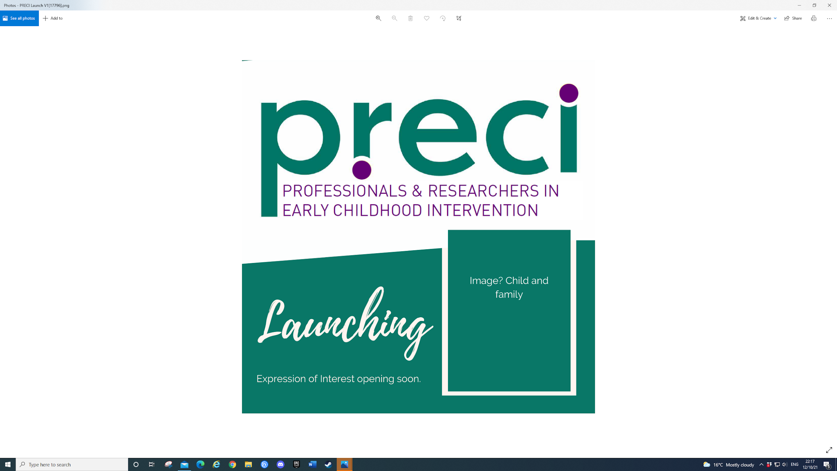


Research Snapshot No. 23
Autism, Identity and Clinical Practice: Supporting Positive Identity Development in Neurodivergent Children and Young People
Eloise Stark, James Stacey & Matthew TD Knight
February 2026
In the spirit of reconciliation PRECI acknowledges the Traditional Custodians of country throughout Australia and their connections to land, sea and community. We pay our respect to their Elders past and present and extend that respect to all Aboriginal and Torres Strait Islander peoples today.
Presented by… Anoo Bhopti, PhD

Slide 2

What you need to know
•
Neurodivergent identity is a vital component of overall well-being.
Clinicians can reinforce stigma or empower young people through their "epistemic power".
Identity is co-constructed through relationships with significant others in a child's life – including the interface with clinicians/professionals they meet
Notes:
Neurodivergence is an umbrella term to refer to people whose neurodevelopment falls outside of (or ‘diverges’ from) the range usually considered to constitute ‘typical’ development, including being autistic (Pellicano & den Houting, 2022).
Social Identity Theory (SIT; Tajfel & Turner, 1979) suggests that individuals tend to categorise themselves and others into social groups, deriving a sense of identity and self-concept from group membership. This affiliation can contribute to well-being and self-esteem by providing a sense of belonging and shared meaning. Researchers have explored autistic identity development in relation to the stigma towards autism within society, demonstrating that experiences of discrimination, internalised stigma and masking one’s autistic identity are associated with poorer mental health outcomes (Botha & Frost, 2020).
professionals’ conceptualisations of autism significantly shape how autistic people are treated and understood – at worst, promoting cues for ableism, including dehumanisation and stigmatisation. The interactions that children have with professionals in diagnostic and support services, therefore, have important implications for identity development.
Epistemic power is the power to decide what counts as “truth.” Epistemic power refers to the power to shape what is accepted as knowledge, whose perspectives are seen as credible, and whose voices are heard or dismissed.
We are shifting from deficit-based medical models that pathologise difference to neuroaffirmative frameworks that recognise autism, ADHD and other neurodivergence as valid forms of human diversity, meaning clinicians’ language and beliefs directly shape how young people understand themselves.

Slide 3
What is this research about?
Explores how Child and Adult Mental Health Service (CAMHS) clinicians facilitate positive identity development.
Identifies enablers and constraints within clinical practice.
Focuses primarily on autistic young people with multiple neurodivergent diagnoses
Notes:
Define CAMHS please

Slide 4
What did the researchers do?
9 semi-structured interviews with a multidisciplinary clinical team (psychologists, psychiatrists, social workers, etc.).
Utilised Interpretative Phenomenological Analysis (IPA).
Conducted within a UK CAMHS Neurodevelopmental Conditions service
Notes:
9 semi-structured interviews with a multidisciplinary clinical team (psychologists, psychiatrists, social workers, etc.).
• Utilised Interpretative Phenomenological Analysis (IPA). - Interpretative Phenomenological Analysis, or IPA, is a qualitative research approach that explores in depth how individuals make sense of their lived experiences. It uses small, focused samples to allow detailed, case-by-case analysis, prioritising depth over breadth.
• Conducted within a UK CAMHS Neurodevelopmental Conditions service

Slide 5
What did the researchers find?
Theme 1: A Flexible Neuroaffirmative Concept of Positive Autistic Identity
Theme 2: Being Honest and Balanced: Acknowledging Challenges for Young Autistic People
Theme 3: Developing an Identity Through Relationships with Others
Theme 4: Professional Vulnerability in Navigating Neurodivergent Identities: The Importance of Self-Reflexivity
Notes:
Theme 1: This theme describes how clinicians are moving away from traditional, deficit-based medical models toward validating neurodivergent ways of being. The paper highlights that professionals now strive to foreground autistic strengths and use respectful, non-pathologising language to help young people see themselves positively. Clinicians often act as "narrators of identity," intentionally "sowing seeds" of positive self-concept by focusing on what makes a young person unique rather than what is "wrong" with them.
Theme 2: Being honest and balanced: acknowledging challenges for young autistic people While clinicians promote a positive outlook, this theme acknowledges the real-world adversity and stigma neurodivergent youth face. The researchers found that clinicians must validate the emotional impact of feeling "different" or "othered" in a world designed for neuronormative brains. The paper also points to systemic barriers, such as long diagnostic waiting lists and a lack of post-diagnostic support, which can lead to low self-esteem and mental health challenges if not addressed honestly.
Theme 3: Developing an identity through relationships with others This theme explains that a child’s identity is not formed in isolation but is co-constructed through interactions with family, peers, and professionals. The paper suggests that identity is socially and relationally embedded, meaning that how a child sees themselves is deeply influenced by how those around them—especially parents and teachers—perceive and respond to their differences. Creating neuroaffirmative environments where a child feels understood is critical for developing a sense of belonging and collective self-esteem.
Theme 4: Professional vulnerability in navigating neurodivergent identities: The importance of self-reflexivity The final theme highlights that clinicians are not neutral observers; their own values, biases, and lived experiences of neurodiversity shape how they support young people. Some clinicians reported feeling personally vulnerable when their own family histories or neurodivergent traits intersected with their clinical work. The authors conclude that "reflective spaces" are essential for staff to process these personal-professional intersections, ensuring they remain open and responsive to the individual needs of the families they serve

Slide 6
How can you use this research?
Audit Clinical and Educational Language: Move from deficit-based to neuroaffirmative terminology.
Act as an Active "Narrator of Identity": Support young people by "sowing seeds" of positive self-concept.
Foster Collective Self-Esteem: Connect young people with neurodivergent communities and peers.
Create Reflective Professional Spaces: Engage in self-reflexivity regarding your own relationship to neurodiversity.
Advocate for Systemic Change: Use qualitative evidence to push for resources, training, and policy shifts.
Notes:
Audit Clinical and Educational Language "The research emphasizes that clinicians and educators hold 'epistemic power' through the language they choose. We need to move away from pathologising, ableist language like 'impairment' or 'disorder' and instead use neuroaffirmative terms such as 'co-occurring'. By doing this, we stop framing neurodivergence as a set of deficits to be cured and start framing it as a valid form of human diversity. This shift helps prevent the internalised stigma that leads to poorer mental health outcomes."
Act as an Active "Narrator of Identity" "Clinicians and teachers are not neutral observers; our interactions profoundly shape a child's developing perception of themselves. We should see our role as 'narrators of identity' who actively resist pathologising narratives. This means moving away from 'problem-oriented talk' and instead 'sowing seeds' of a positive self-concept by highlighting a young person's unique strengths and skills. We need to be the ones 'fighting the young person’s corner' to ensure they feel worthy and accepted."
Foster Collective Self-Esteem "Identity development is not a solitary process; it is relationally and socially embedded. We can use this research to facilitate community connectedness, helping young people find a sense of belonging within the broader neurodivergent community. Research shows that collective self-esteem—the pride in one's group identity—is a protective factor that increases overall self-esteem and well-being. We must also work with families and schools to ensure these environments affirm neurodivergence rather than excluding it."
Create Reflective Professional Spaces "A novel finding in this research is the importance of professional self-reflexivity. We need dedicated spaces to reflect on our own personal and professional relationships with neurodiversity, including our own biases and 'living' experiences. This practice is essential for maintaining professional humility, which means acknowledging what we don't yet know and remaining open to learning from our neurodivergent clients and students."
Advocate for Systemic Change "Finally, we can use these findings as qualitative evidence to advocate with centre leadership and policy-makers. This research proves that meaningful inclusion is not just about proximity—like having a child in the room—but about active participation that requires specific resources, training, and active teacher support. We must advocate for systemic changes that embed neurodiversity-informed frameworks across all levels of healthcare and education to reduce the harm caused by long waitlists and under-resourced services

Slide 7
Where to from here?
Co-produce service changes with young autistic people.
Address systemic resource gaps, such as long waiting lists that put mental health at risk
Links to this article
  Autism, Identity and Clinical Practice: Supporting Positive Identity Development in Neurodivergent Children and Young People
Other Links
  Autistic identity: A systematic review of quantitative research
Notes:
• Co-produce service changes with young autistic people.
• Address systemic resource gaps, such as long waiting lists that put mental health at risk
It would be good to other links or other resources

Slide 8
About the researchers
The authors - Eloise Stark, James Stacy and Mathew TD Knight work at
Oxford Institute for Clinical Psychology Training and Research, Oxford Health NHS Foundation Trust and University of Oxford, Oxford, UK
Oxford Health NHS Foundation Trust, Warneford Hospital, Oxford, UK
Centre for Eudaimonia and Human Flourishing, Stoke House, Linacre College, University of Oxford, Oxford, UK
Notes:
• E. Stark, J. Stacey, and M. Knight work at the Oxford Institute for Clinical Psychology Training and Research and the University of Oxford.
• Citation: Stark, E. et al. (2025). Autism, Identity and Clinical Practice. Neurodiversity,

Slide 9
Stark, E., Stacey, J., & Knight, M. T. D. (2025). Autism, identity and clinical practice: Supporting positive identity development in neurodivergent children and young people. Neurodiversity. https://doi.org/10.1177/27546330251370652
Citation
THANK YOU FOR LISTENING!

