Slide 1
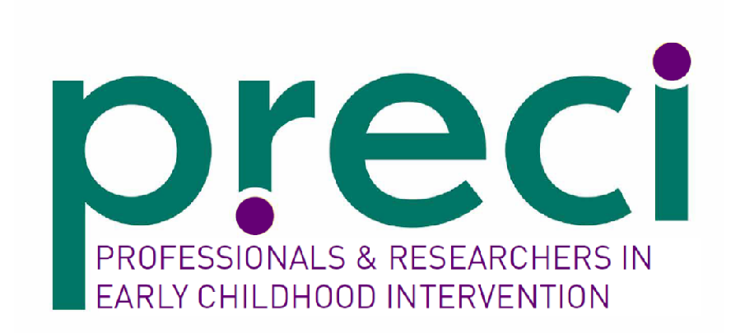


Research Snapshot No. 25
An intervention to improve the self-efficacy of key workers to support parental wellbeing at an early childhood intervention service in Australia, a stepped, wedged randomised control trial.
Young et. al.
June, 2026
In the spirit of reconciliation PRECI acknowledges the Traditional Custodians of country throughout Australia and their connections to land, sea and community. We pay our respect to their Elders past and present and extend that respect to all Aboriginal and Torres Strait Islander peoples today.
Presented by Lauren Falconer, Occupational Therapist
Notes:
at an
early childhood intervention service in Australia: a
stepped wedged randomized cluster trial

Slide 2

What do you need to know?
The fact that parents of children with a disability are at increased risk of challenges with mental health and wellbeing is well established
Provision of emotional support is a central element of effective implementation of the key worker role
Many early childhood intervention practitioners identify supporting parental distress is a challenge in their role, which can have a negative impact on their own wellbeing and job satisfaction

Slide 3
What is this research about?
Trialed a capacity building program, the ‘Pursuit of Wellbeing.’
The program was designed to increase staff knowledge and self-efficacy to manage the wellbeing of parents
Secondary outcomes included parental mental well-being, job-related well-being, parental satisfaction, staff perceptions of supervisory support and cost-effectiveness

Slide 4
What did the researchers do?
Stepped wedge design across six different hubs at the same early childhood intervention service provider
Sequentially exposed participating key workers to the program over an eight month period
Repeat online assessments were completed at baseline, 3 months, 8 months and 12 months following the trial commencing
42 staff and 45 primary carers participated in the trial

Slide 5
What did the researchers find?
While there was a statistically significant improvement in overall self-efficacy over the course of the trial, there was not a statistically significant improvement when considering pre- and post-exposure to the training
Two of the five items on the ‘knowing’ domain did show statistically significant improvements associated with the training
There was also a statistically significant improvement in relation to communication (talking to parents of children with a disability about their own wellbeing) from pre to post intervention

Slide 6
How can you use this research?
This research indicates that providing professional development aimed at enhancing knowledge and skill to support emotional wellbeing can have a positive impact on key worker confidence in some areas
The lack of statistically significant change overall may indicate a need to provide tailored support for implementation of new learning, in line with adult learning principles, to have greater utility of professional development however this requires further exploration
For ECI professionals working in the field, this research highlights the need to consider professional development and learning opportunities related to the implementation of family-centred practices, along with the more ‘traditional’ PD options that focus on discipline specific skills, particularly in the context of a key worker model

Slide 7
How does this research align
with the Framework?
This research aligns most strongly with relationship-based principle of the Framework.
Ensuring practitioners feel confident to support parental wellbeing is critical for the success of a relationship-based approach, given the critical impact the quality of the relationship has on the effectiveness of support

Slide 8
Where to from here?
As a practitioner, consider how confident you feel to effectively support parental wellbeing and how you might build your skills in this area
As a manager of supervisor, consider how you can more effectively support staff to support parental wellbeing in a way that is meaningful, responsive and evidence-based

Slide 9
About the researchers
There were 13 authors who contributed to this work, with Dana Young as the lead author.
Dana Young is a research fellow and PhD Candidate within the Gender & Women’s Health Unit at the Nossal Institute of Global Health with the University of Melbourne School of Population and Global Health. Dana’s research explores the social and environmental infliences on child and family health, and the impact of community based interventions.

Slide 10
Dana Young, John Reynolds, Utsana Tonmukayakul, Rob Carter, Elena Swift, Katrina Williams, Rachael McDonald, Dinah Reddihough, Rod Carracher, Paul Ireland, Jane Tracy, Cassie Kenyon & Lisa Gibbs (2023) An intervention to improve the self-efficacy of key workers to support parental wellbeing at an early childhood intervention service in Australia: a stepped wedged randomized cluster trial, Disability and Rehabilitation, 45:19, 3046-3058, DOI:
10.1080/09638288.2022.2117865
THANK YOU FOR LISTENING!

